Slide 1
RFID RC522 Interfacing with NodeMCU

Slide 2
NodeMCU is a low-cost open source IoT platform.
It is an open source firmware.
It runs runs on the ESP8266 Wi-Fi SoC.
On December 30, 2013, Espressif Systems began production of the ESP8266.
NodeMCU started on 13 Oct 2014

Slide 3
RFID
RFID (radio frequency identification) is a form of wireless communication that incorporates the use of electromagnetic or electrostatic coupling in the radio frequency portion of the electromagnetic spectrum to uniquely identify an object, animal or person.
An RFID sensor is a tag that uses electromagnetic fields to identify and track assets automatically.
RFID system consists of three components:
A scanning antenna,
A transceiver and
A transponder.

Slide 4
RFID Reader
RFID Reader = Antenna + Transceiver .
The RFID reader is a network-connected device that can be portable or permanently attached.
It uses radio waves to transmit signals that activate the tag. Once activated, the tag sends a wave back to the antenna, where it is translated into data.
There are two types of RFID readers:
Fixed readers and
Mobile readers.

Slide 5
RFID Tag
RFID tag is the transponder.
RFID tags are made up of an integrated circuit (IC), an antenna and a substrate.
The part of an RFID tag that encodes identifying information is called the RFID inlay.
The read range for RFID tags varies based on following factors :
Including the type of tag
Type of reader,
RFID frequency and
Interference in the surrounding environment or from other RFID tags and readers.
Active RFID: An active RFID tag has its own power source, often a battery.
Passive RFID: A passive RFID tag receives its power from the reading antenna, whose electromagnetic wave induces a current in the RFID tag's antenna.

Slide 6
RFID Systems
There are three main types of RFID systems:
Low-frequency RFID systems. These range from 30 KHzto 500 KHz, though the typical frequency is 125 KHz. LF RFID has short transmission ranges, generally anywhere from a few inches to less than six feet.
High-frequency RFID system These range from 3 MHzto 30 MHz, with the typical HF frequency being 13.56 MHz. The standard range is anywhere from a few inches to several feet.
UHF RFID systems. These range from 300 MHz to 960 MHz, with the typical frequency of 433 MHz and can generally be read from 25-plus feet away.
Microwave RFID systems. These run at 2.45 Ghz and can be read from 30-plus feet away.
Frequencies vary greatly depending on country and region.

Slide 7
Difference between RFID tags and Bar Codes
RFID tags | Barcodes
Can identify individual objects without direct line of sight. | Direct line of sight required for scanning.
Can scan items from inches to feet away, depending on type of tag and reader. | Require closer proximity for scanning.
Data can be updated in real time. | Data is read-only and can't be changed.
Require a power source. | No power source needed.
Read time is less than 100 milliseconds per tag. | Read time is half a second or more per tag.
Contain a sensor attached to an antenna, often contained in a plastic cover and more costly than barcodes. | Printed on the outside of an object and more subject to wear

Slide 8
RFID applications
pet and livestock tracking
inventory management
asset tracking and equipment tracking
cargo and supply chain logistics
vehicle tracking

Slide 9
Node MCU PIN Configuration
NodeMCU provides access to the GPIO (General Purpose Input/Output) and a pin mapping table is part of the API documentation.
I/O index | ESP8266 pin
0 [*] | GPIO16
1 | GPIO5
2 | GPIO4
3 | GPIO0
4 | GPIO2
5 | GPIO14
6 | GPIO12
7 | GPIO13
8 | GPIO15
9 | GPIO3
11 | GPIO9
12 | GPIO10

Slide 10
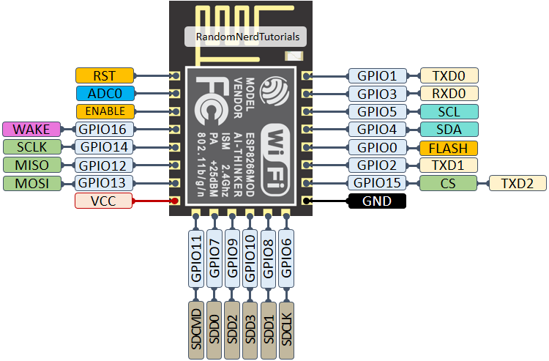
Node MCU PIN DIAGRAM

Slide 11
MFRC522 RFID Reader Interfaced With NodeMCU
NodeMCU
MFRC522 RFID Reader
RFID Tags ( 13.56 MHz )
Bread Board
Jumper Wires
Micro USB Cable
Specifications
Input voltage: 3.3v
Frequency: 13.56MH

Slide 12
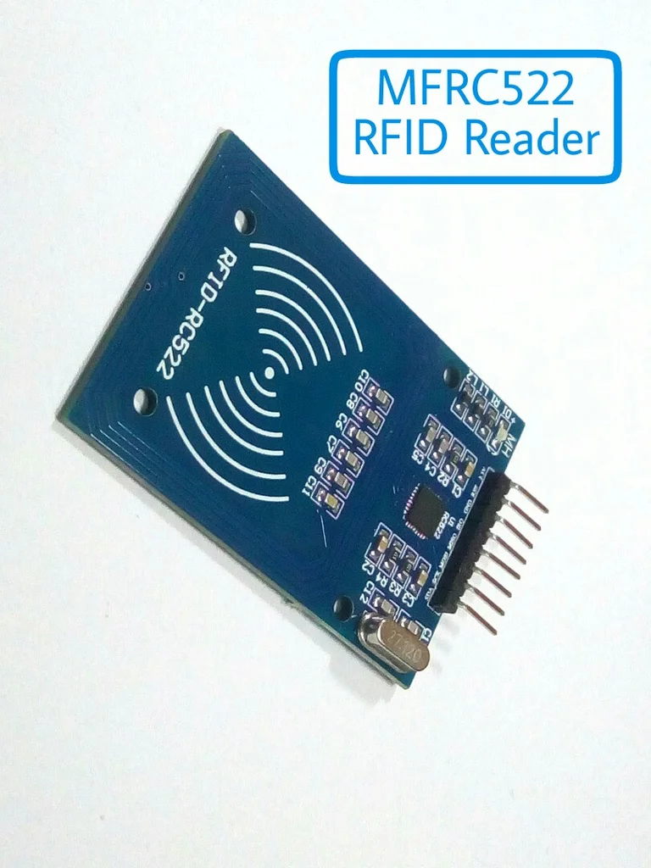
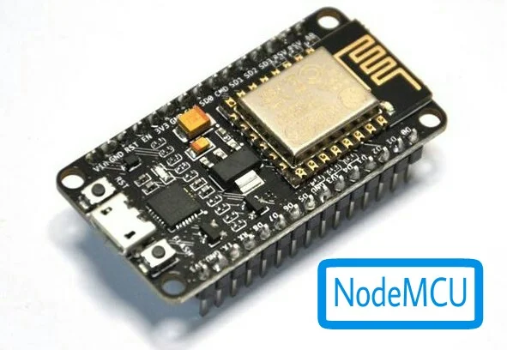

Slide 13
Interface Servo Motor with NodeMCU
Steps to include libraries for RFID in Arduino:
Download the RFID library here created by miguelbalboa.
Unzip the RFID library.
Install the RFID library in your Arduino IDE.
Restart your Arduino IDE

Slide 14
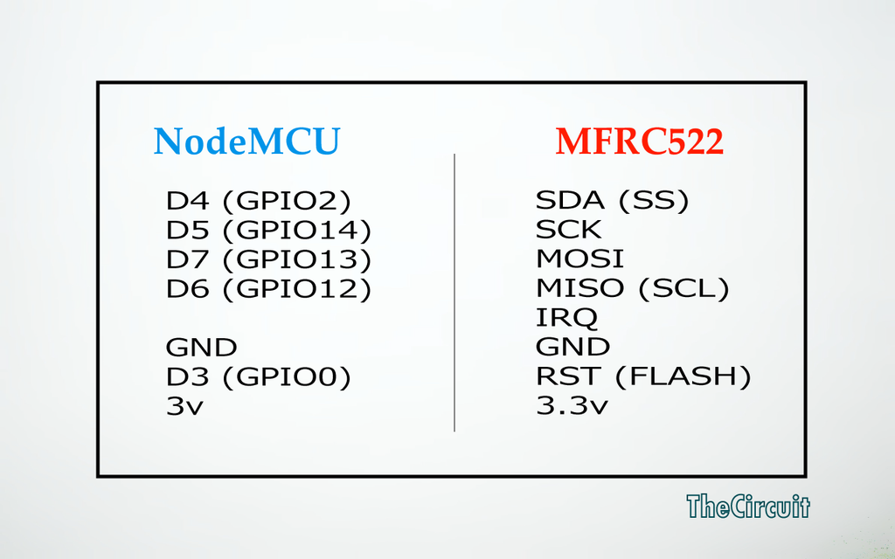
Connection

Slide 15
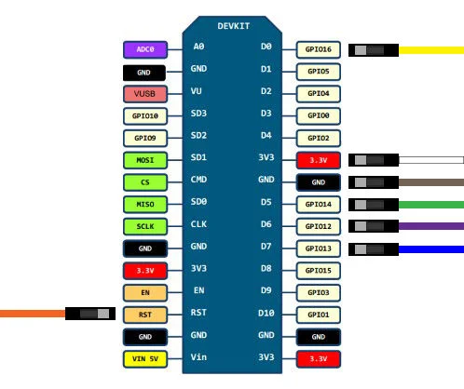
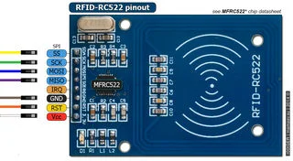
Node MCU with RFID RC522

